Slide 1

INTELLIGENT TRAFFIC MONITORING SYSTEM

Slide 2



Agenda
PROBLEM STATEMENT
STATISTICS
WORKING PRINCIPLE
SOLUTION ARCHITECTURE
COMPONENTS USED
ADVANTAGES
CONCLUSION

Slide 3




PROBLEM STATEMENT
Vehicle travel across the world is increasing, especially in larger urban areas. Traffic congestions is a serious problem in many major cities around the world.
In today’s world there is no efficient traffic system, one way of providing efficient traffic system is by manipulating traffic lights dynamically based on the traffic density.
A traffic control system continuously senses and monitors traffic conditions and adjusts the timing of traffic lights according to the actual traffic load which is known as an Intelligent Traffic Control System.

Slide 4

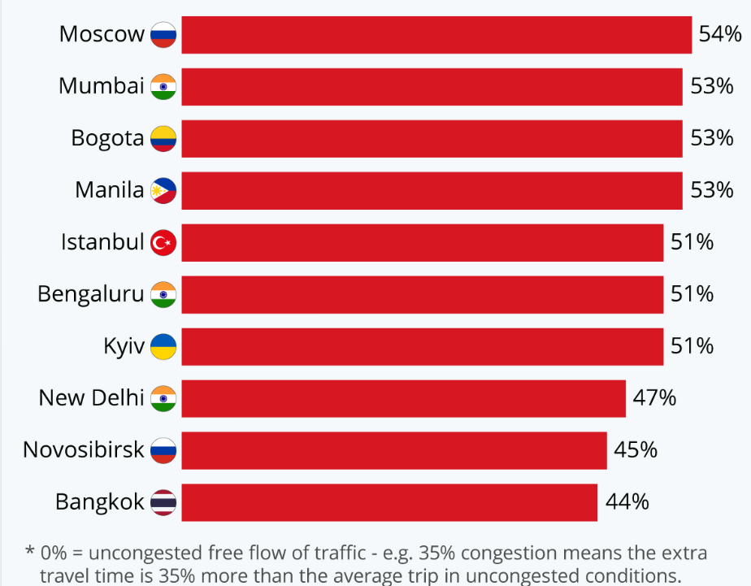
STATISTICS

Slide 5
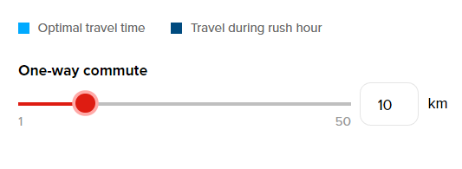
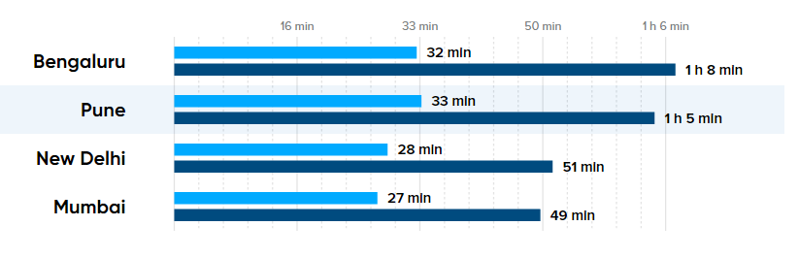

Slide 6
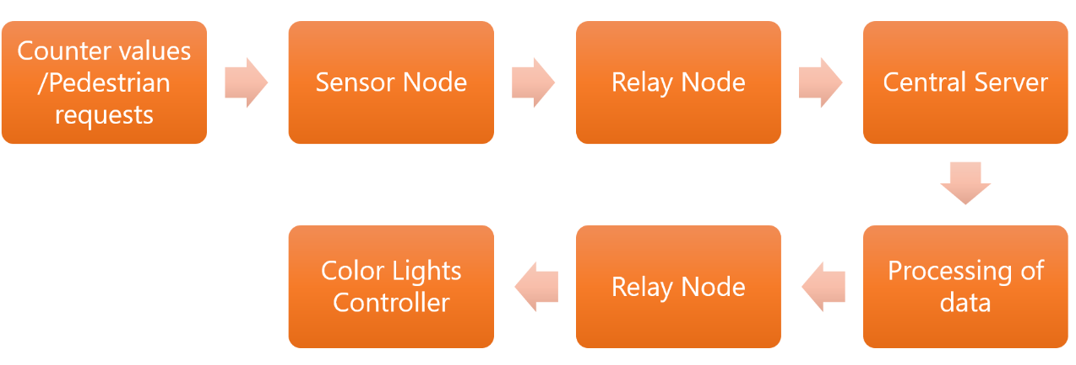
WORKING PRINCIPLE

Slide 7
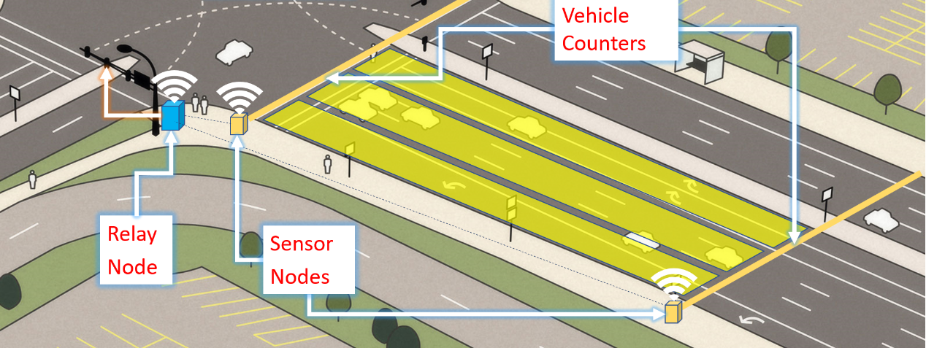
SOLUTION ARCHITECTURE

Slide 8
COMPONENTS USED
Arduino Mega board works as the microcontroller for the sensor node.
Ultrasonic sensors used to measure the vehicle density on each line
Relay module is used to switch electrical devices and systems on or off and it isolates the control circuit from the device or system being controlled.
Node MCU V1.0 is used as Wi-Fi-Module which is used to connect cloud.
LED represents the Traffic Light
Resistors
Breadboard
Connecting Wires

Slide 9
ADVANTAGES
Avoids wastage of time due to traffic
Fully automated
Low power consumption
Low cost to design the circuit
No need of traffic inspector at the junction.
Fuel consumption of vehicles in traffic is also conserved.
Maintenance of the circuit is easy.

Slide 10

CONCLUSION
The proposed system is an efficient and highly economic solution to traffic problems in metropolitan cities in India, where exponentially increasing traffic is a growing concern.
The system is easy to implement, doesn’t involve a great deal of complex computation, includes real world parameters.
This system will be able to sense the presence or absence of vehicles and act accordingly. This system can help to crack the problem of traffic congestion.
Reduces the waiting time of each lane of the cars and also to maximize the total number of cars that can cross an intersection.

Slide 11


Thank You

